Slide 1



Namma Yatri data analysis
-Data-Driven insight & strategic recommendations
Business Analysts:
ZAYED SYED
GSS VINAY
SRUSHTI KESKAR

Slide 2

About Namma -Yatri
Namma Yatri is a Direct-to-Driver open mobility platform developed by Juspay, designed to power the next generation of mobility applications in India. Since its official launch in January 2023, it has become Bengaluru’s most loved auto-rickshaw app.
Let me know if you'd like it to sound more formal, promotional, or tailored for a specific audience (e.g., investors, users, media).

Slide 3
Purpose and Goals
Project Overview:
Review of data analysis findings to inform technical development.
Focus on system optimization, feature enhancement, and performance.
Translating insights into actionable development tasks.
Key Objective:
Understand user behavior, ride performance, and revenue drivers
Outcome: Actionable insights and technical suggestions.

Slide 4
Purpose and Goals
Project Overview:
Review of data analysis findings to inform technical development.
Focus on system optimization, feature enhancement, and performance.
Translating insights into actionable development tasks.
Key Objective:
Understand user behavior, ride performance, and revenue drivers
Outcome: Actionable insights and technical suggestions.

Slide 5
Data Integration and Structure
Overview of data sources and tables(Assembly, Duration, Payment, Trip Details, Trips) — A high-level summary of each dataset, its purpose, and its structure.
Explanation of data joins and relationships— Description of how the tables are connected, key join conditions, and the relational model used.
Discussion of data types and potential for normalization/optimization— Analysis of data types, schema design, and opportunities to enhance performance or reduce redundancy through normalization.

Slide 6
Handling Peak Demand
Identification of peak demand periods:
(Notably 8–10 AM and 5–8 PM) — Analysing usage trends to highlight critical time windows for system load.
Assessment of infrastructure impact: Evaluating implications on server load, database performance, and overall system scalability during peak times.
Proposed performance strategies : Implementing techniques such as load balancing, caching, and queue management to ensure smooth and efficient operations

Slide 7
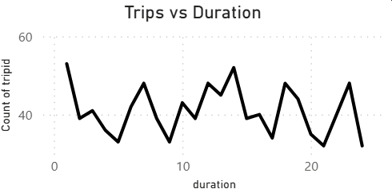
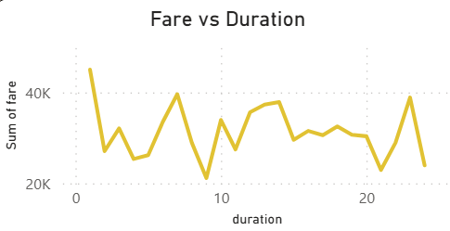
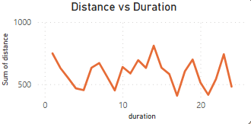
Revenue-Related Data Points
Analysis of fare data and its relation to trip duration and time of day.
Considerations for dynamic pricing algorithms or surge pricing features
Secure and efficient handling of payment data
Technical Considerations:
  Implementation of fare calculation logic.
  Integration with payment gateways.
  Data security and compliance (e.g., PCI DSS).

Slide 8
Geospatial Data and Analysis
  Importance of location data (loc_from, loc_to, Assembly).
  Technical challenges and opportunities related to location accuracy, geocoding, and routing.
  Analysis of high-performing zones and implications for service availability.
Technical Considerations:
  Use of mapping libraries and APIs.
  Optimization of location-based queries.
  Real-time location updates and tracking.

Slide 9
User Behaviour - Feature Development
  Analysis of user interactions (searches, estimates, quotes, OTP).
  Insights into user behaviour and potential areas for feature improvement.
  Emphasis on the impact of quote searches on trip completion.
Technical Considerations:
  Implementation of search and quote functionality.
  User interface/user experience (UI/UX) considerations.
  Data logging and analytics for user behaviour tracking.

Slide 10
Handling Cancellations
  Review of cancellation rates and their impact on the system.
  Technical strategies for reducing cancellations (e.g., real-time updates, communication features).
  Importance of cancellation reason tracking.
Technical Considerations:
  Implementation of cancellation mechanisms.
  Notification systems and real-time updates.
Data storage and analysis of cancellation reasons.

Slide 11
System Performance
  Identifying key performance indicators (KPIs) (e.g., response time, error rates).
  Strategies for monitoring, testing, and optimizing system performance.
  Importance of scalability and reliability.
Technical Considerations:
  Load testing and performance profiling.
  Code optimization and refactoring.
  Server infrastructure and resource management.

Slide 12
API Design and Integration
  Review of API endpoints and data exchange formats.
  Security considerations for APIs.
  Strategies for API versioning and documentation.
Technical Considerations:
  API design principles (e.g., RESTful APIs).
  Authentication and authorization.
  Data serialization and deserialization (e.g., JSON).

Slide 13
Future Development- Next Steps
  Roadmap for implementing recommended features and optimizations.
  Prioritization of development tasks.
  Considerations for new technologies or architectural changes.
Discussion Points:
  Microservices architecture.
  Real-time data streaming.
  Machine learning for predictive analysis.

Slide 14
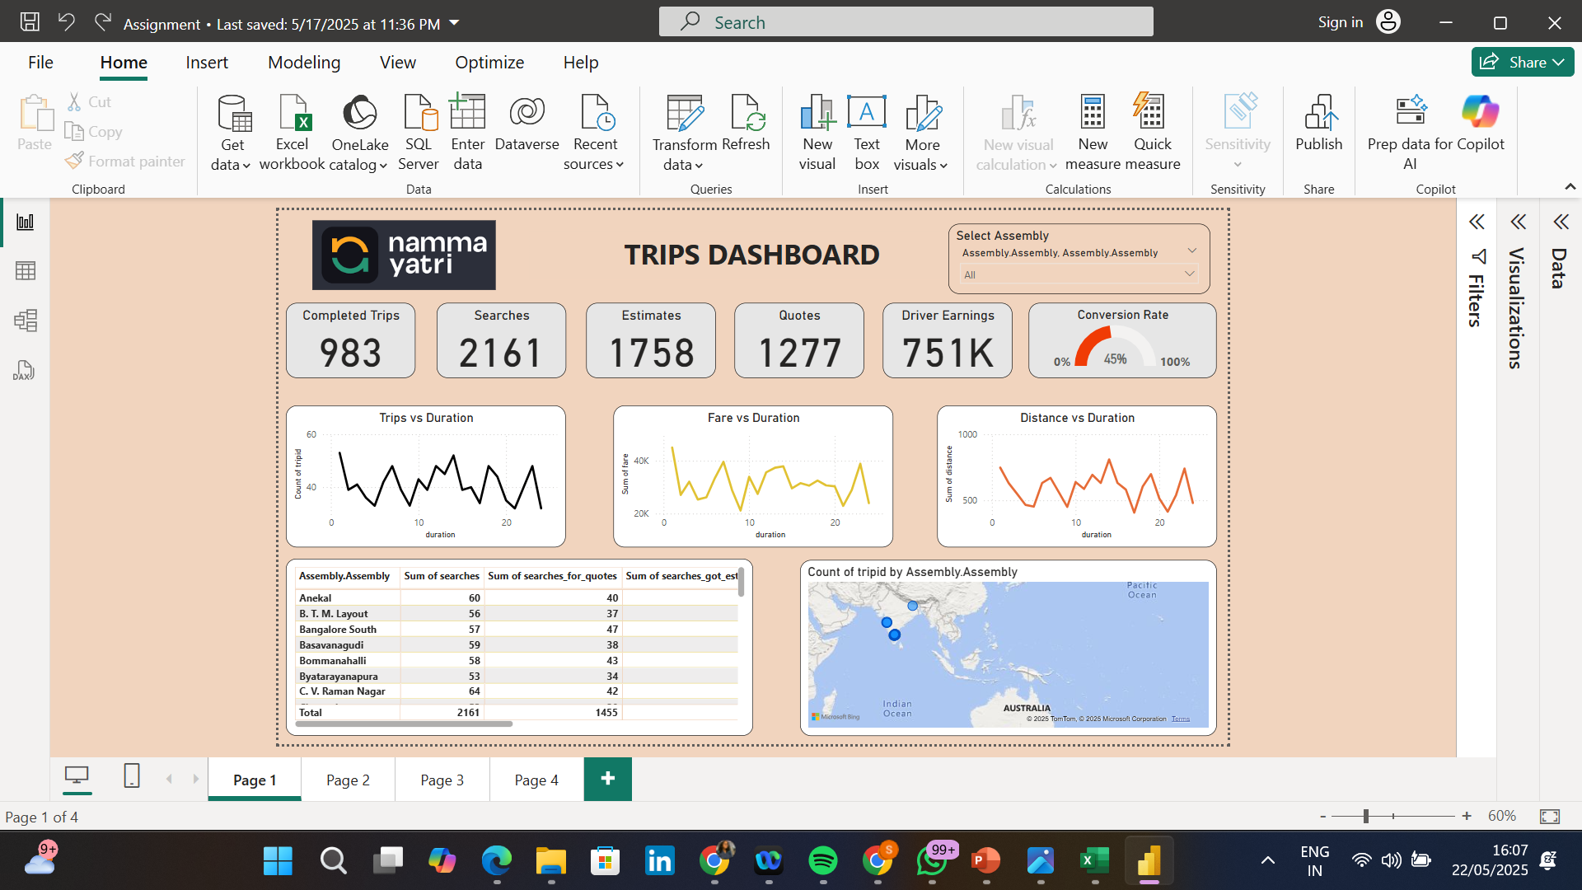
Power BI Dashboard

Slide 15
Thank You

